Slide 1
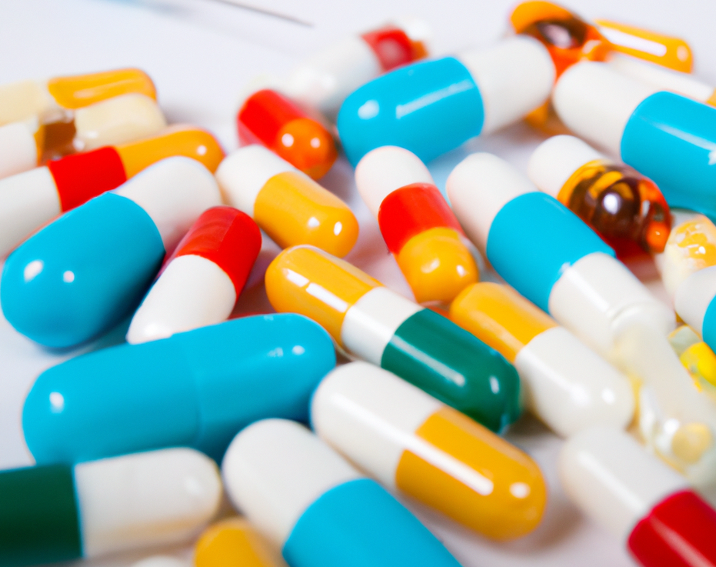
PharmBERT
A domain-specific BERT model for drug labels
Taha ValizadehAslani, Yiwen Shi, Ping Ren, Jing Wang, Yi Zhang, Meng Hu, Liang Zhao, Hualou Liang. “PharmBERT: a domain-specific BERT model for drug labels”. Briefings in Bioinformatics. 2023.

Slide 2
PharmBERT
A large language model for drug label data
Developed at Liang Lab, Drexel University
For the FDA
Well-received
Publicly available for the NLP community

Slide 3



Large Language Models (LLMs)
BERT, XLNet, Gemini
There is a race in the NLP community to develop new LLMs!
Different industries are incorporating LLMs to increase their efficiency
Human-level performance
GPT-1 , GPT-2, GPT-3 , GPT-4
OPT, LLaMA
3

Slide 4
Pre-training and Fine-tuning
Large number of parameters requires a large training set to converge
Labeled data is often limited
Common paradigm in NLP: pre-training and fine-tuning
Model pre-trained on massive unlabeled text …
And fine-tuned on a domain-specific task
Problem: The distribution of the words might be different in the final task
Solution: Domain specific pre-training
BioBERT, LEGAL-BERT, ClinicalBERT

Slide 5
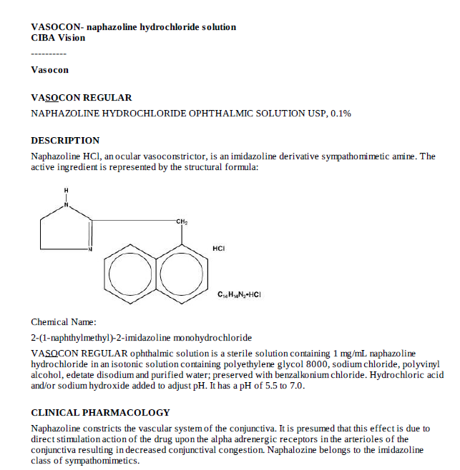
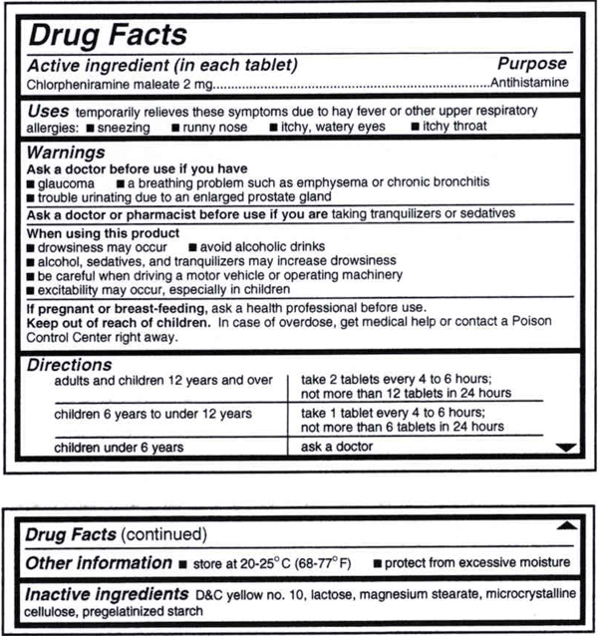
Drug label
Drug label refers to any information provided with prescription drugs, monitored by regulatory agencies, such as the FDA
You have seen these labels enclosed in the box of any drugs that you purchase from your local pharmacy
They are unstructured and messy text…
… but contain a lot of useful information

Slide 6
Drug
label
Finding adverse reaction
Therapeutic and safety equivalence clustering
Finding the interaction with other drugs
PSG assessment enhancement

Slide 7
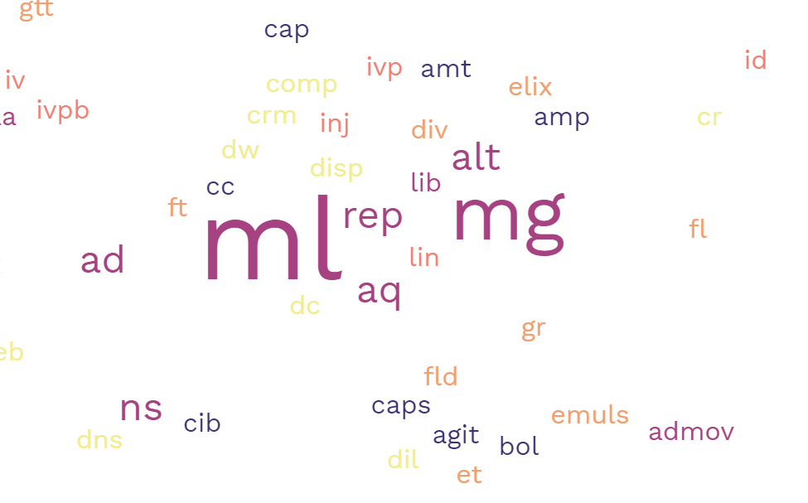
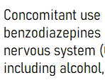
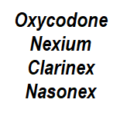
Drug label text idiosyncrasies
Pharmacological notations, such as “mcg/mL”, are used quite frequently.
We hypothesize that drug label is a separate domain, different from general English, or scientific biological text!
Drug labels vocabulary distribution
Scientific and Latin terms are very common.
Some letters, like X, are more common in drug names

Slide 8
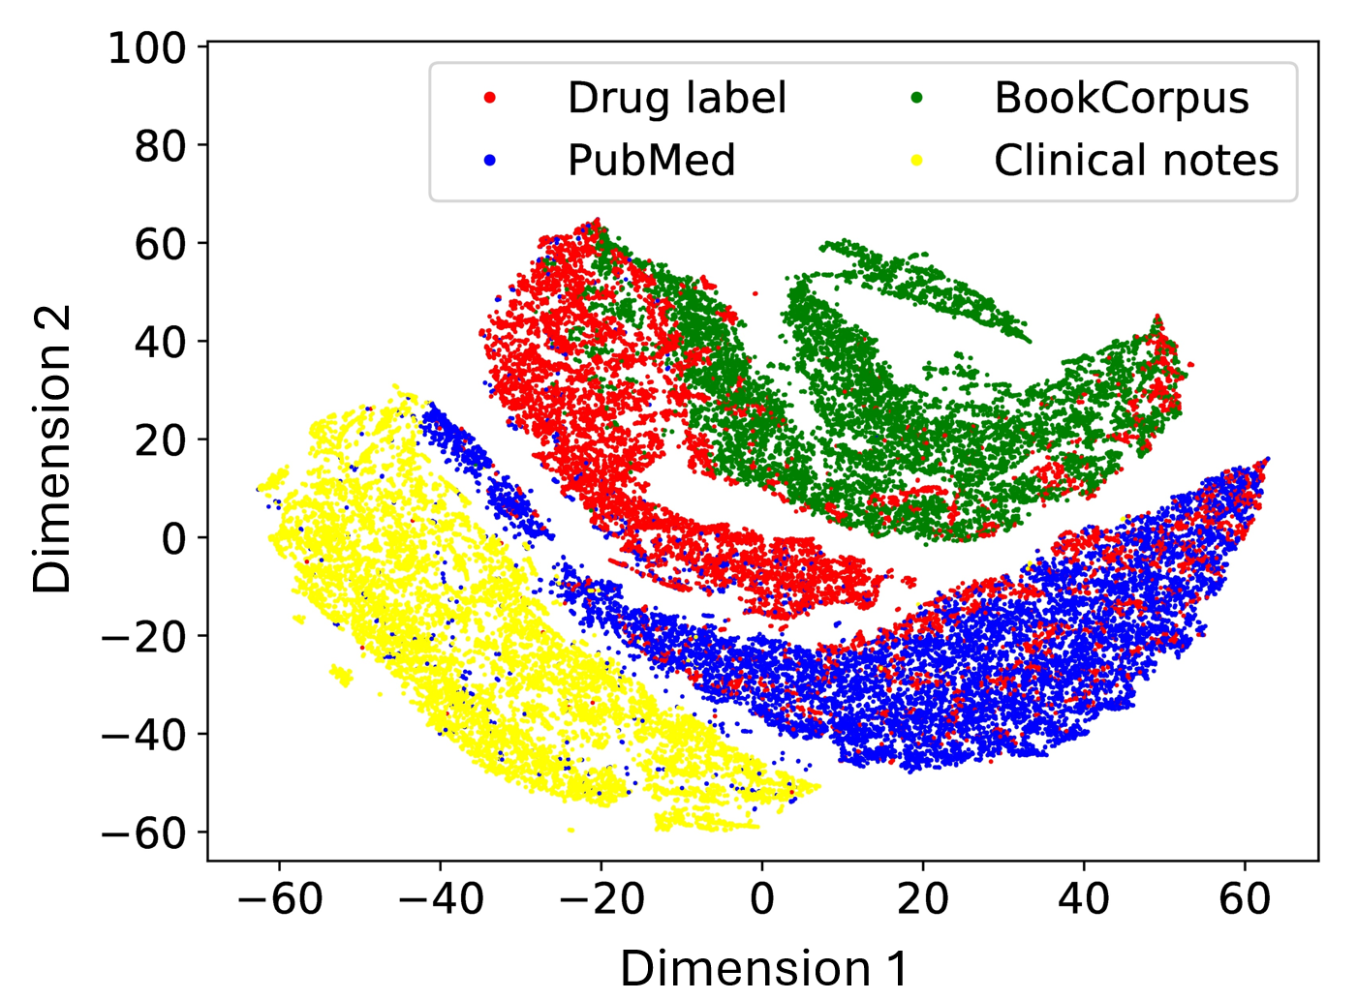
Nature of drug label text
Testing the hypothesis
BERT Embeddings
Different domains cluster together
Domains: drug labels, general English, clinical notes, and PubMed scientific abstracts
t-SNE visualization

Slide 9

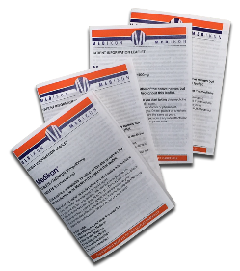
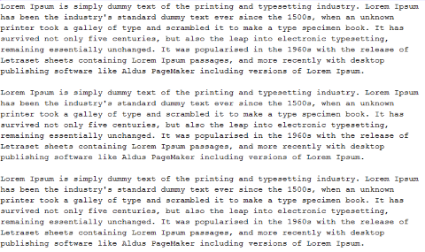
Without domain-specific pre-training
With domain-specific pre-training
Generic corpora
Generic corpora
Generic pre-training
Generic pre-training
Drug label domain corpora
Drug label domain pre-training
Drug label domain fine-tuning
Drug label domain fine-tuning
Drug label task
Drug label task

Slide 10
Tokenization
How to show text to the model:
Tokenization
A mapping from words to symbols that the model can understand (tokens)
WordPiece tokenizer
Uncased Tokenizer
my
name
is
ta
##ha
.
My name is Taha.
Cased Tokenizer
My
name
is
Ta
##ha
.

Slide 11
Masked Language Model (MLM)
How did we perform pretraining?
MLM!
We mask one word in the input and ask the model to predict the masked word.
This enables us to train the model with unlabeled data.
We started from BERT base checkpoints and continued pre-training
DailyMed training data

Slide 12

Bidirectional Encoder Representations from Transformers (BERT)
PharmBERT is based on BERT
BERT revolutionized NLP field and marked the beginning of a new era in NLP
12 layers, 110 million parameters (BERT base)
Pre-trained on English BooksCorpus (800M words) + Wikipedia (2,500M words)
Used in Google search
There are many domain-specific BERT models: BioBERT, LEGAL-BERT, ClinicalBERT
But there is no BERT for drug labels
Devlin, J., Chang, M. W., Lee, K., & Toutanova, K. (2018). Bert: Pre-training of deep bidirectional transformers for language understanding. arXiv preprint arXiv:1810.04805.

Slide 13


Masked language model example
Cars
C
In
spring
Flowers
?
bloom
.
BERT
[CLS]
In
spring
[MASK]
bloom
.

Slide 14
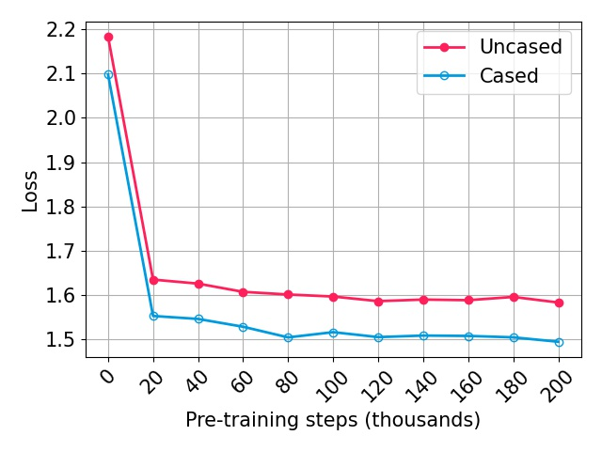
MLM loss as a function of pre-training steps
Sharp drop with the initial exposure
Slow drop with more exposure

Slide 15
Fine-tuning PharmBERT
To test the performance of PharmBERT, we fine-tuned it on 3 different NLP tasks on drug labels:
Detection of adverse drug reaction
Drug-drug Interaction
ADME classification
We benchmarked PharmBERT against vanilla BERT, ClinicalBERT, and BioBERT.

Slide 16
Detection of Adverse Drug Reaction (ADR)
What are the adverse reactions of this drug?
Data source: 2017 Text Analysis Conference (TAC 2017)
Extract adverse reactions and their related mentions (severity, factor, drug class, negation, animal) from the drug labels.
Multi-class word classification
Roberts, K., Demner-Fushman, D., & Tonning, J. M. (2017, November). Overview of the TAC 2017 Adverse Reaction Extraction from Drug Labels Track. In TAC.

Slide 17
ADR
Exclusive of an uncommon, mild injection site reaction, no adverse reactions to 11 C-choline have been reported.
Input
Output
AdverseReaction
AdverseReaction
AdverseReaction
0
0
0
0
Severity
0
0
0
0
0
0
0
0
0

Slide 18
ADR results
Model | Mean F1 (standard error)
BERT base uncased | 0.8769 (0.0016)
BERT base cased | 0.8700 (0.0017)
ClinicalBERT | 0.8760 (0.0029)
BioBERT | 0.8897 (0.0009)
PharmBERT uncased | 0.8923 (0.0012)
PharmBERT cased | 0.8845 (0.0007)

Slide 19
Extraction of Drug-Drug Interaction (DDI)
Next task: DDI
Eighth leading cause of death in the United States of America
Does this drug interfere with other drugs?
Data source: SemEval-2013 Task 9.2
Multi-class text classification
Segura-Bedmar, I., Martínez Fernández, P., & Herrero Zazo, M. (2013). Semeval-2013 task 9: Extraction of drug-drug interactions from biomedical texts. Association for Computational Linguistics.

Slide 20
DDI
No interaction trials have been conducted with MEPRON and rifabutin.
No DDI
Clinical implications of warfarin interactions with five sedatives.
Int
Aminoglutethimide diminishes the effect of coumarin.
Effect
In vitro, propranolol appears to be displaced from its binding sites by diltiazem.
Mechanism
Therefore, indomethacin and diflunisal should not be used concomitantly.
Advise

Slide 21
Extraction of Drug-Drug Interaction (DDI)
Model | Mean F1 (standard error)
BERT base uncased | 0.7814 (0.0027)
BERT base cased | 0.7772 (0.0072)
ClinicalBERT | 0.7672 (0.0030)
BioBERT | 0.7905 (0.0036)
PharmBERT uncased | 0.8047 (0.0045)
PharmBERT cased | 0.8005 (0.0050)

Slide 22
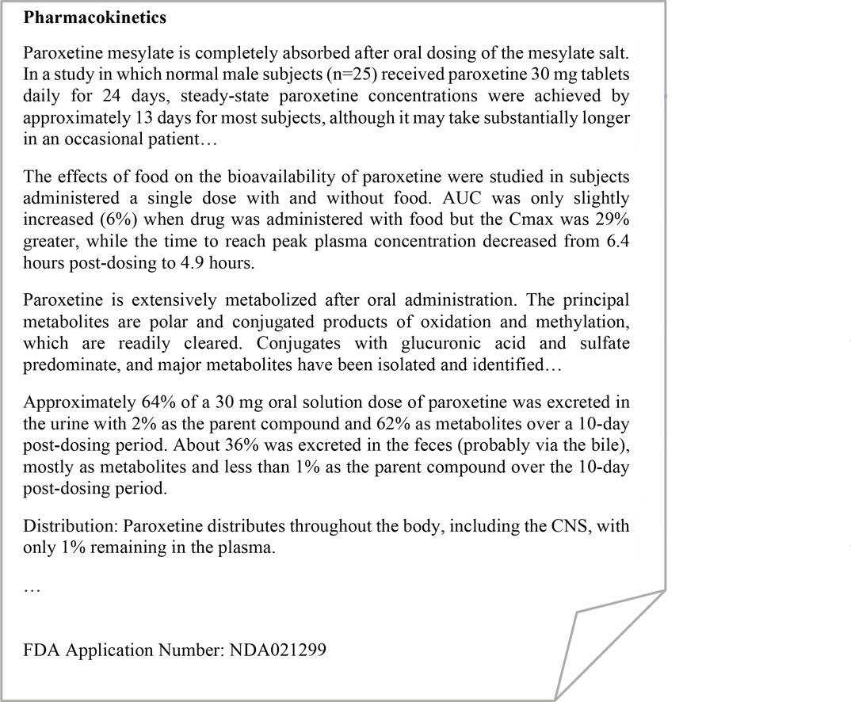
ADME
Pharmacokinetics text classification
Enhance assessment of PSGs
FDA assessor needs to classify text into absorption, distribution, metabolism, excretion, and others
Multi-class text classification
Automating ADME classification can help the FDA assessor
Absorption
Absorption
Metabolism
Excretion
Distribution
Shi, Y., Wang, J., Ren, P., ValizadehAslani, T., Zhang, Y., Hu, M., & Liang, H. (2023). Fine-Tuning BERT for Automatic ADME Semantic Labeling in FDA Drug Labeling to Enhance Product-Specific Guidance Assessment. Journal of Biomedical Informatics, 104285.

Slide 23
ADME
Model | Mean F1 (standard error)
BERT base uncased | 0.9025 (0.0029)
BERT base cased | 0.9021 (0.0033)
ClinicalBERT | 0.9033 (0.0035)
BioBERT | 0.9116 (0.0019)
PharmBERT uncased | 0.9132 (0.0026)
PharmBERT cased | 0.9165 (0.0036)

Slide 24
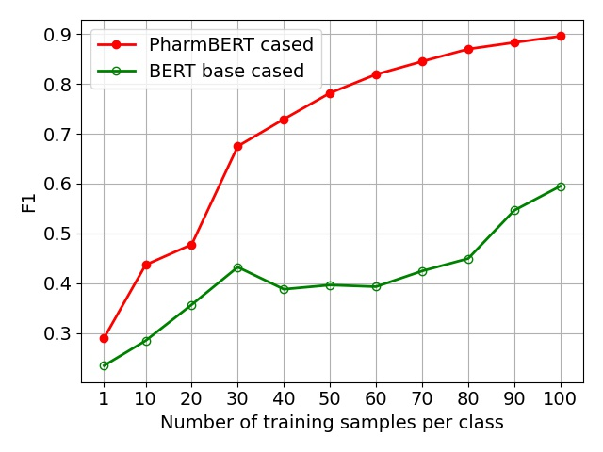
ADME – few-shot learning
Language models can store knowledge from pre-training data.
Is the pre-training knowledge responsible for the good performance of PharmBERT?
Hypothesis: PharmBERT performs better than the vanilla BERT if number of fine-tuning samples is limited.
Because, here, the model cannot learn the knowledge during fine-tuning.
Significant gap

Slide 25
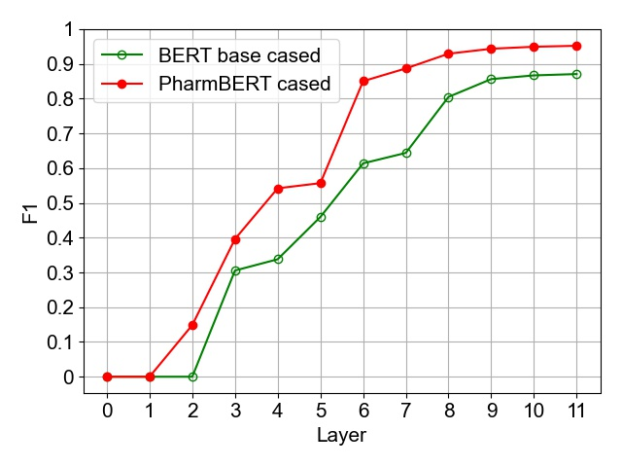
ADME – Ablation study
How good are the intermediate layers for the classification?
We trained a new single layer classifier on the embeddings of each one of the 12 layers for the ADME classification task
Significant gap

Slide 26
How does the model change?
Which parts of the model change during the pre-training?
In order to compare the models, we fed the text to two different models and extracted the attention values.
We computed the cosine similarity between the output of attention mechanisms

Slide 27
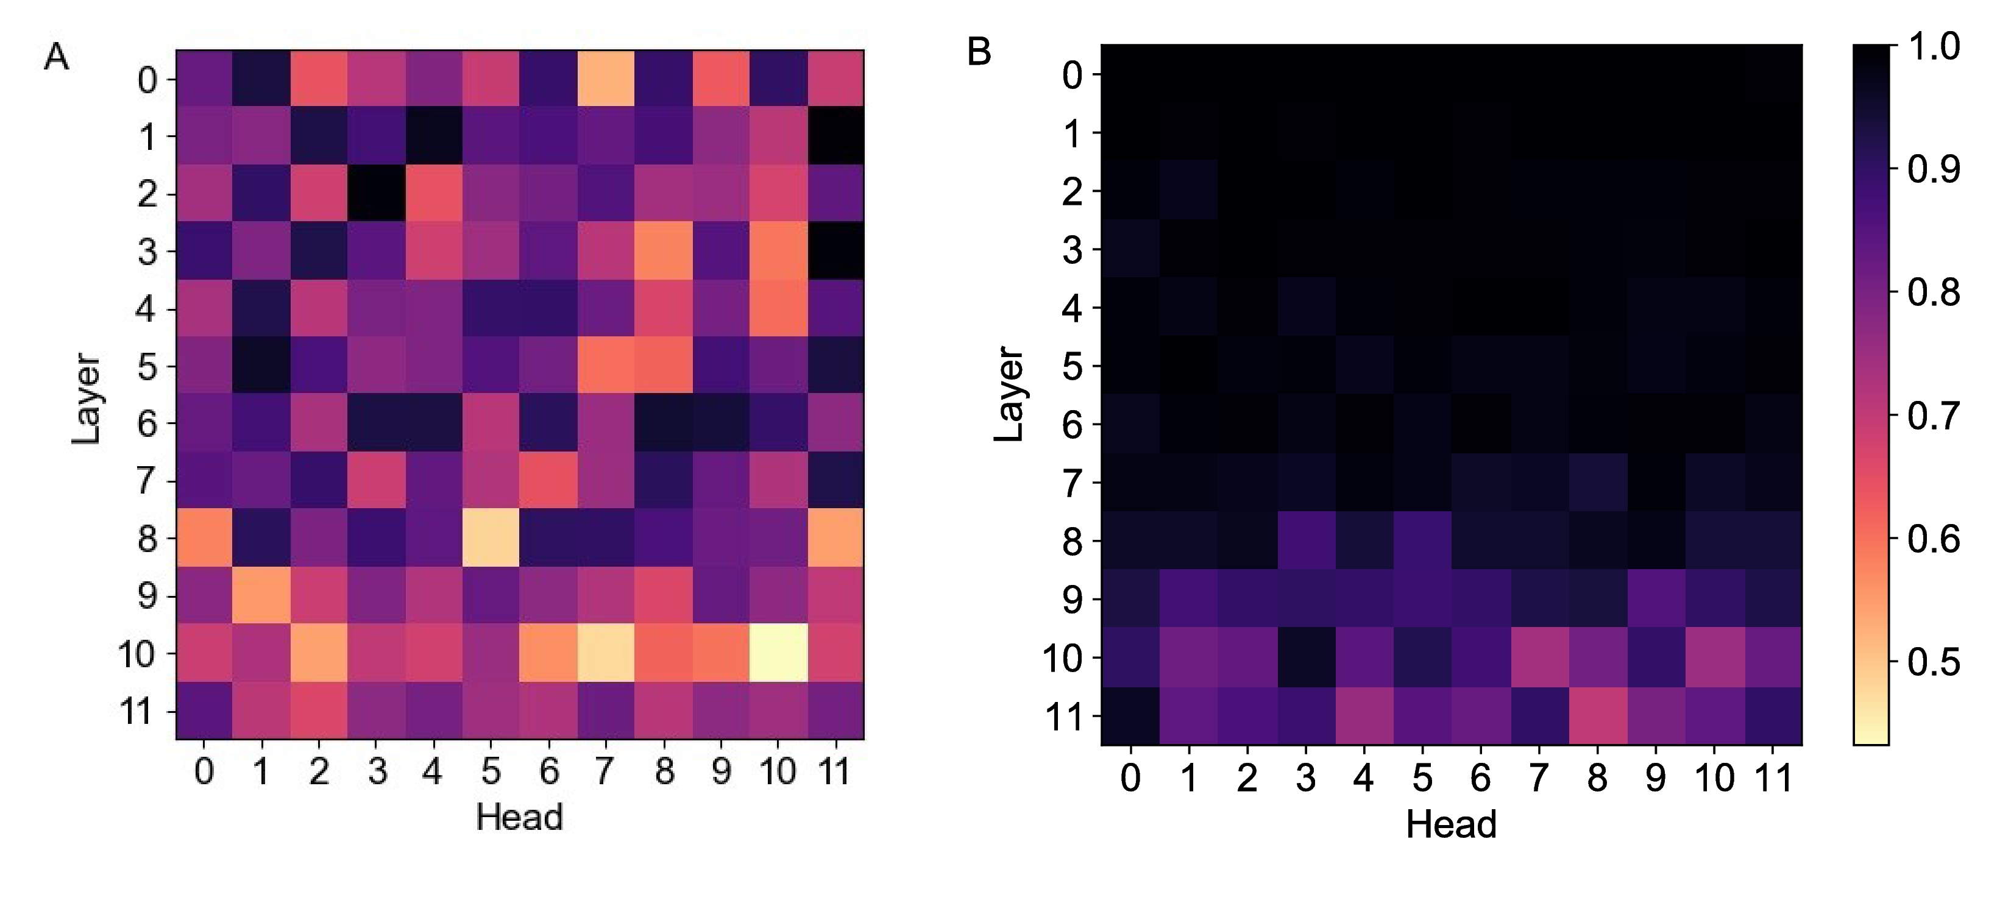
ADME – intermediate checkpoints
Drastic change in all layers
Change only in the final layers
Comparing models before and after pre-training
Comparing models before and after fine-tuning

Slide 28
Conclusions
Drug label is a different domain of text
Needs a domain-specific model
We trained such models and named them PharmBERT
Cased and uncased
Employed by FDA
Publicly available
Perform better than other existing BERT models on drug label tasks!

Slide 29

Thank you for your attention!

Slide 30

Model architecture
PharmBERT Pre-training
PharmBERT Fine-tuning
Pre-training Data
E_{CLS}
C
Drug-label Tasks
E_{CLS}
C
CLS
12 x
Transformer
Encoder
Layer
12 x
Transformer
Encoder
Layer
12 ×
Transformer
Encoder
Layer
T₁
ARD
DDI
ADME
…
12 ×
Transformer
Encoder
Layer
T₁
E₁
E₁
. . .
. . .
. . .
. . .
E_{N}
T_{N}
E_{N}
T_{N}

Slide 31
ADR
Exclusive of an uncommon, mild injection site reaction, no adverse reactions to 11 C-choline have been reported.
Severity
AdverseReaction

Slide 32
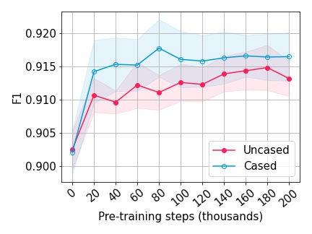
ADME – intermediate checkpoints
To monitor the process of domain-specific pre-training, we can look at the performance of the intermediate checkpoints (rather than using the final pre-trained model)
Slow increase with more exposure
Fast increase with the initial exposure

Slide 33
Control experiment: SST-2
Is the superior performance of PharmBERT is due to the domain-specific pre-training?
Or confounding factors, such as simply having more training steps?
We tested the models on a generic English downstream task, which is not relevant to the drug label
Stanford Sentiment Treebank-2 (SST-2): Binary sentiment analysis for movie reviews: Is this movie review negative or positive?
Model | Mean F1 (standard error)
BERT base uncased | 0.9219 (0.0013)
BERT base cased | 0.9128 (0.0006)
ClinicalBERT | 0.8926 (0.0015)
BioBERT | 0.8995 (0.0015)
PharmBERT uncased | 0.9115 (0.0019)
PharmBERT cased | 0.9089 (0.0020)
Socher, R., Perelygin, A., Wu, J., Chuang, J., Manning, C. D., Ng, A. Y., & Potts, C. (2013, October). Recursive deep models for semantic compositionality over a sentiment treebank. In Proceedings of the 2013 conference on empirical methods in natural language processing (pp. 1631-1642).

